Slide 1
Венгерские туристические ресурсы глазами туриста
Krylova Darya
Volkova Katya
Nogay Nastya

Slide 2
Live in action!
Active leisure in Hungary
Active leisure in Kazakhstan
Suggestions and
recommendations

Slide 3
Novotel Hotels as a hotel for active leisure
Novotel Hotel 4* is situated in Székesfehérvár
This hotel is one of the Accord hotels.
96 rooms
Fitness-spa; 5 multifunctional meeting rooms

Slide 4
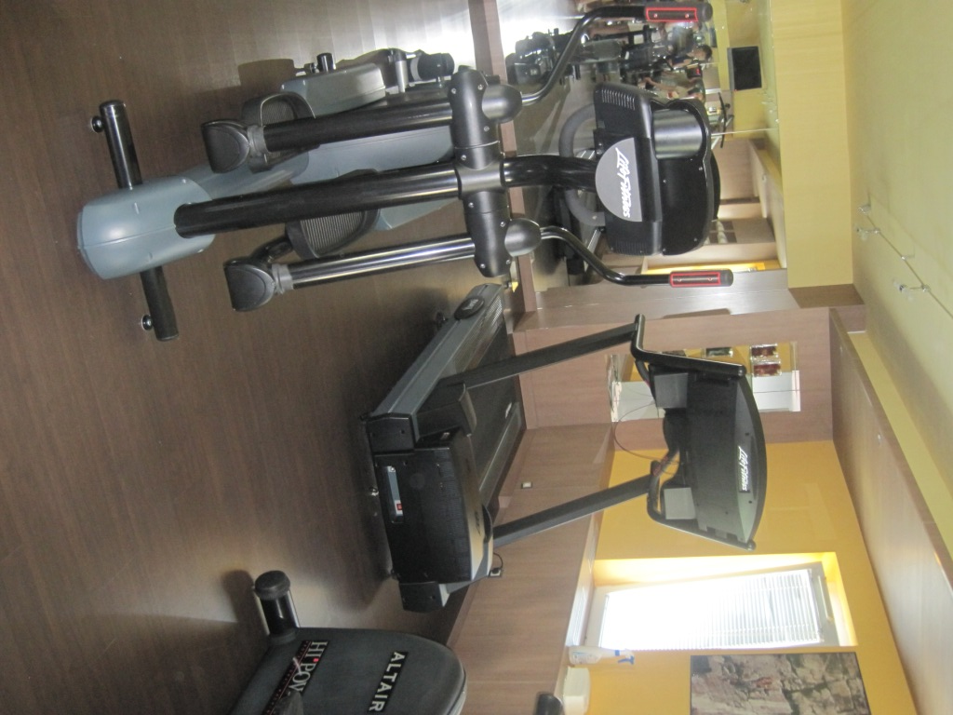
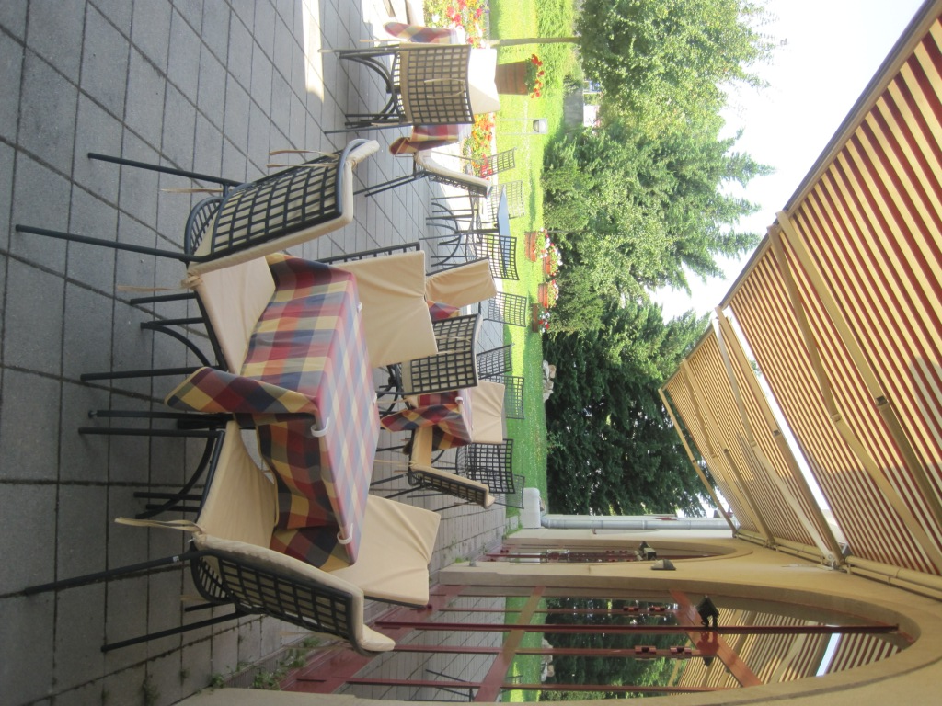
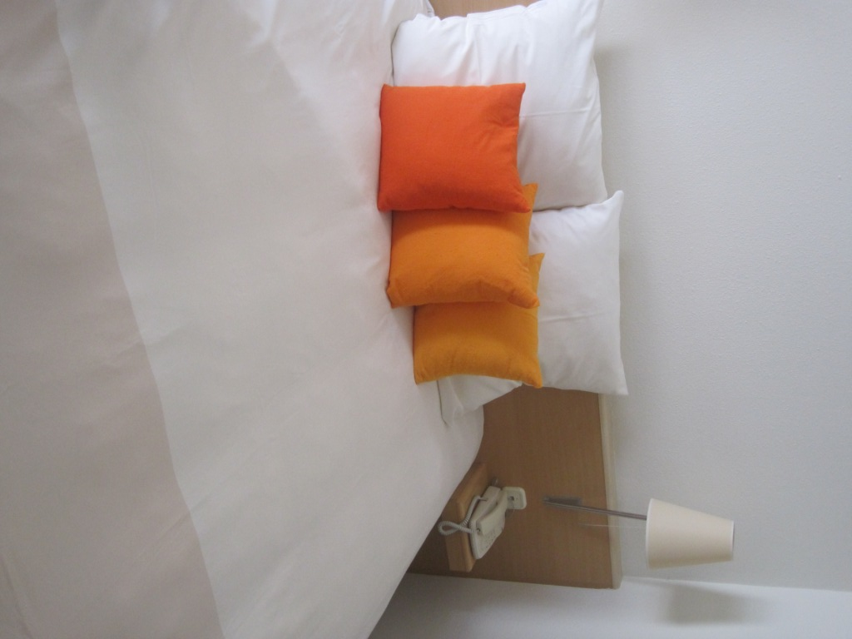
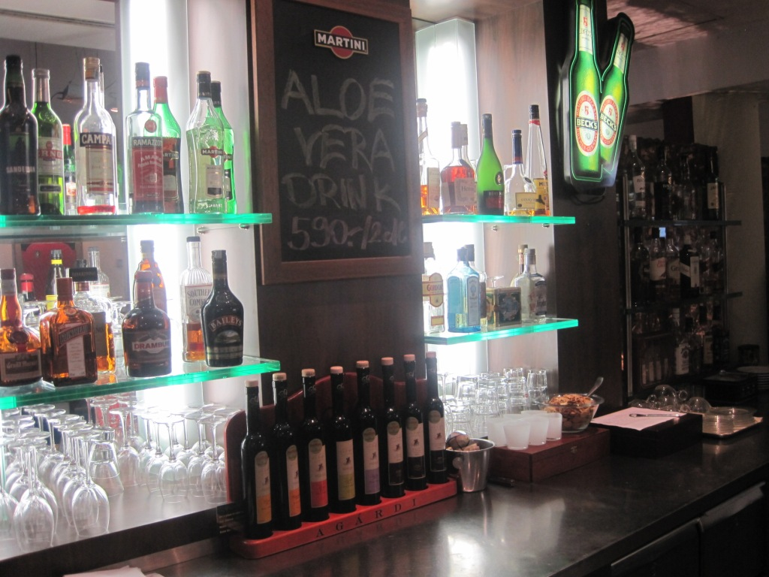

Slide 5
SWOT- analysis
+
Special rooms for sportsmen and tourists
Price (136 EU/day)
Little fitness-SPA without swimming pool
Size of the hotel
Transfer
-
Location
Tour programs
Focus on business

Slide 6
Royal Walk project
The objective is to attract tourists for a few days not hours.
 | Funding EU | Local contribution | In total
Mini mundus Playground Main square lightning | 3 636 532 | 702 188 | 4 338 720
Ruin Garden | 2 883 850 | 550 292 | 3 434 142
In total | 6 520 382 | 1 252 480 | 7 772 862

Slide 7
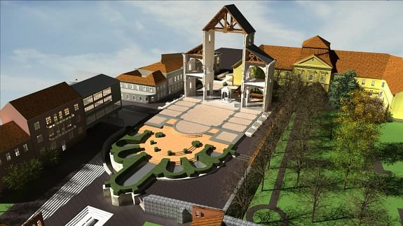
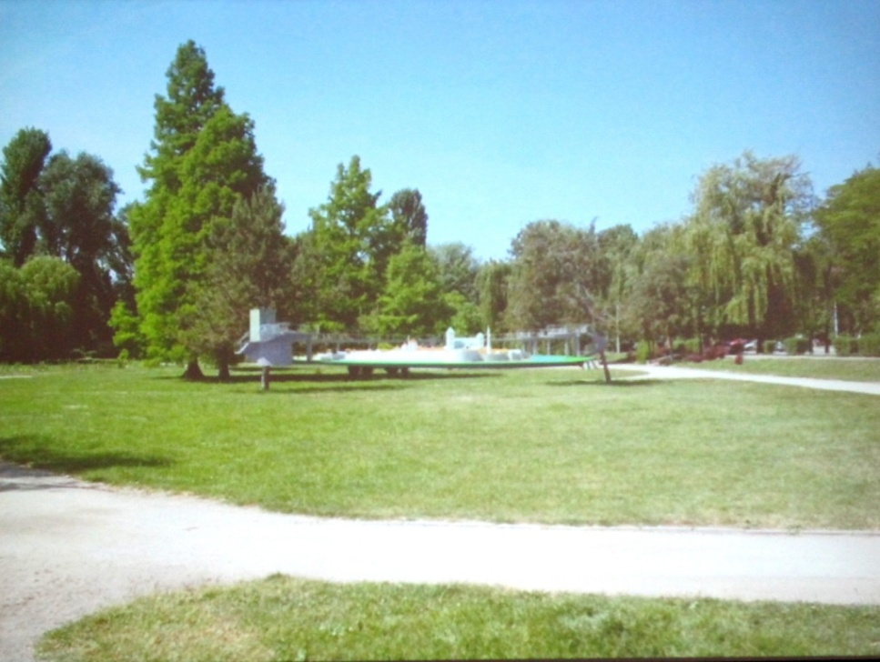
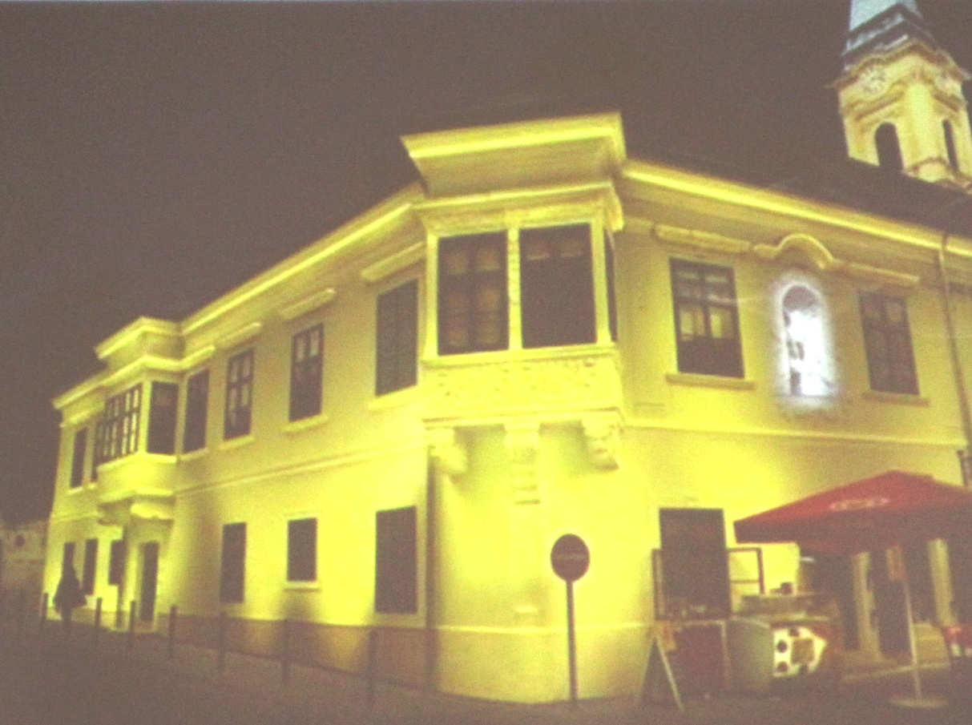
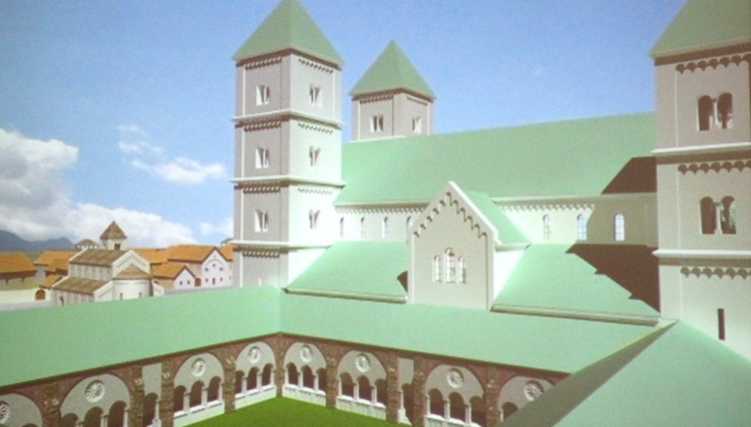
Royal Walk planning

Slide 8
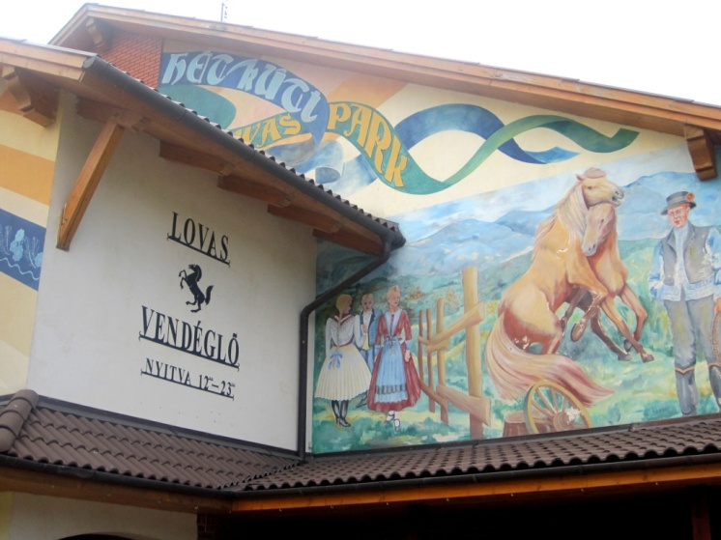
Hetkuti Wellness Hotel 4* Lovas Vendéglő
The Hetkuti-dulo, where the hotel and its 70-acre large Horse Park is located, lies at the foot of the Vertes Mountains in the North-Western part of Hungary.
The hotel opened its doors in 2004, and is characterized by modern elegance.
39 rooms

Slide 9
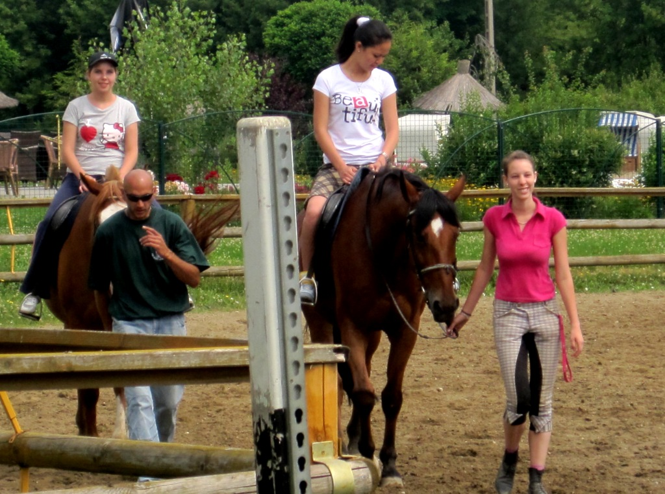
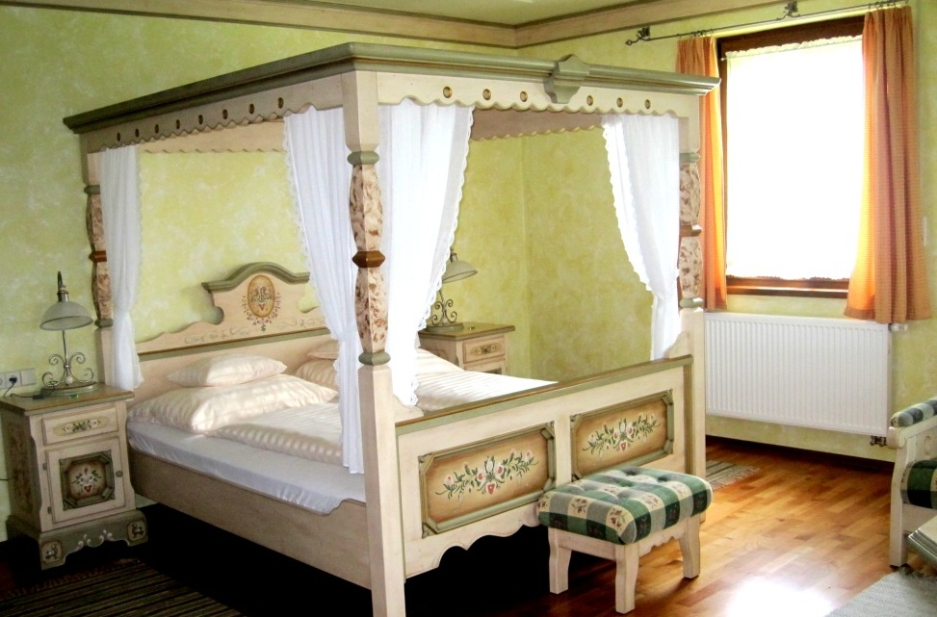
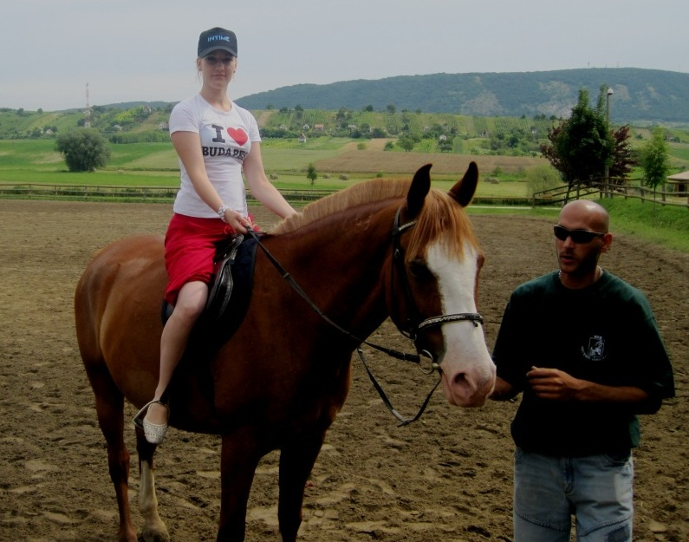
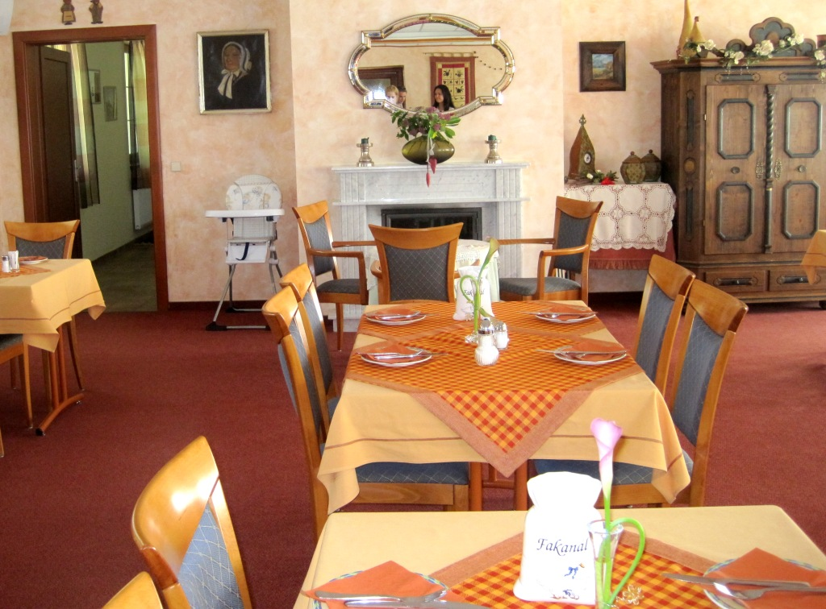

Slide 10
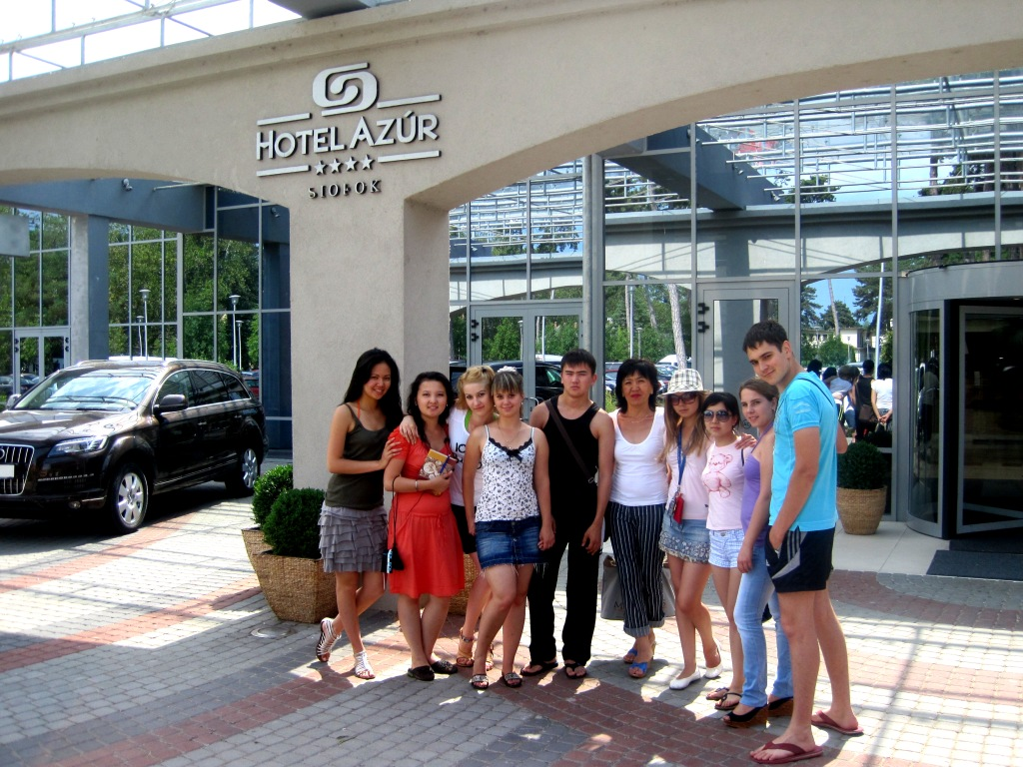
Wellness Hotel AZUR 4*
222 rooms
+ 49 rooms new additional building
6 meeting rooms
Wellness club
Beach
Big swimming pool

Slide 11
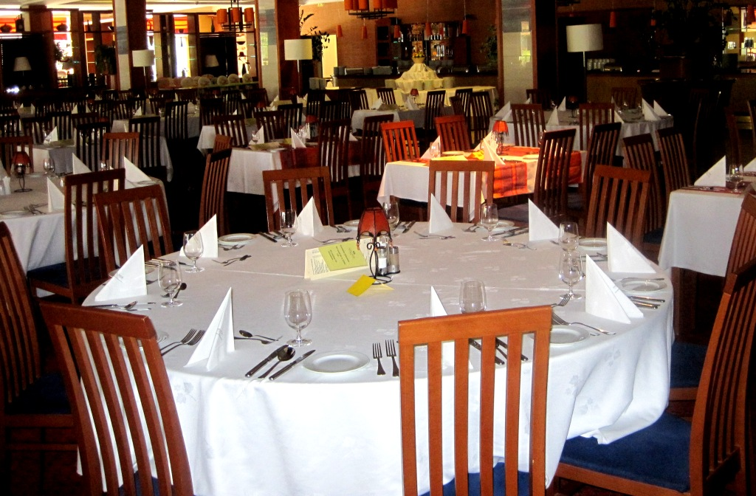
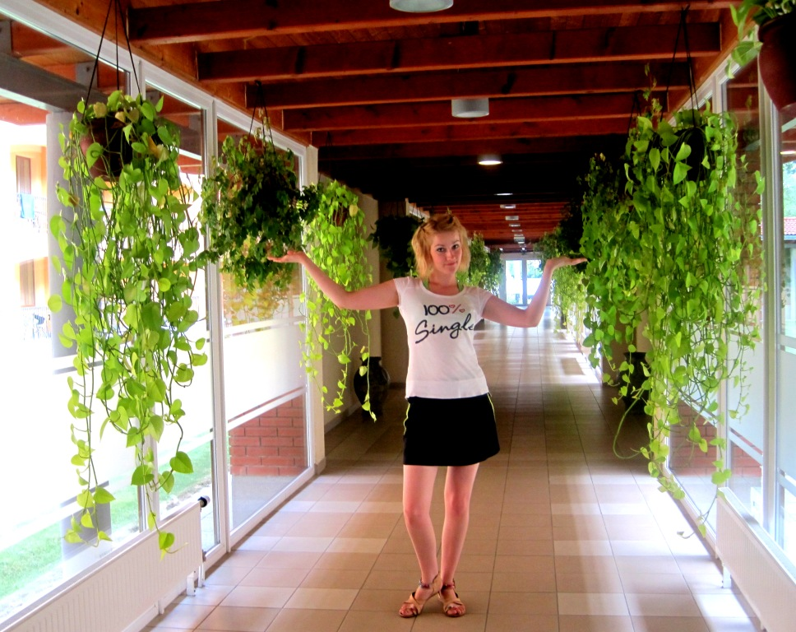
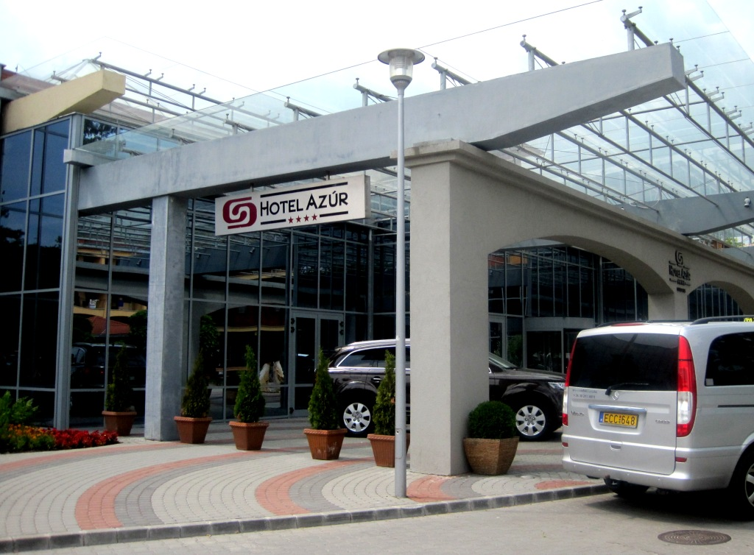

Slide 12
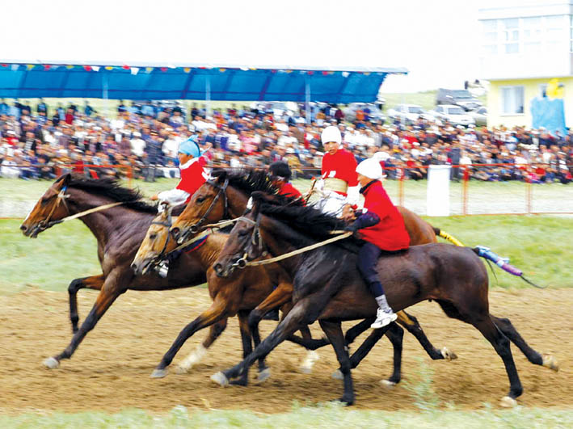
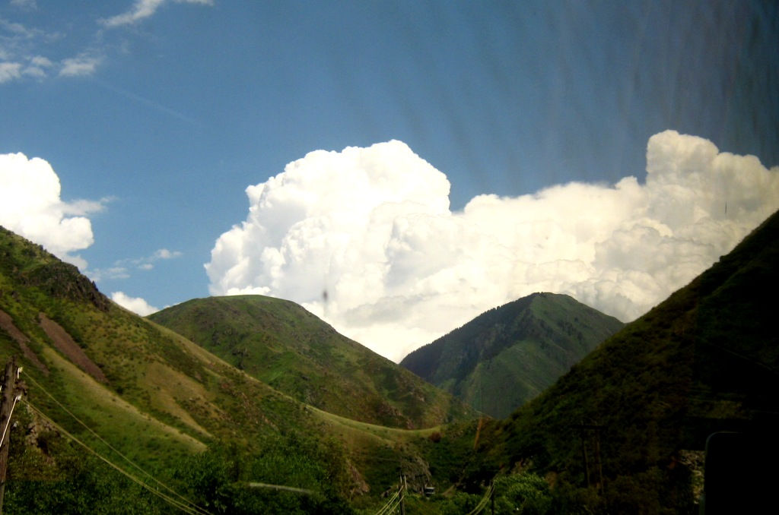
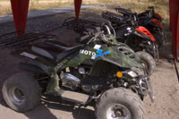
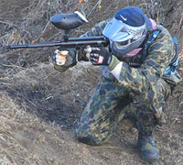
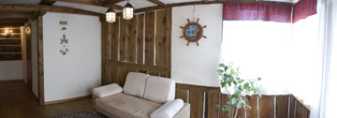
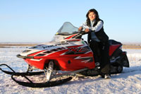
Active leisure in Kazakhstan

Slide 13
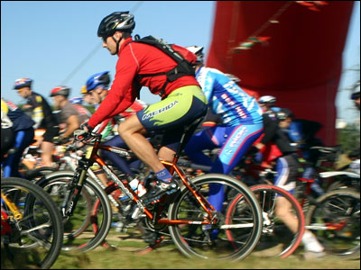
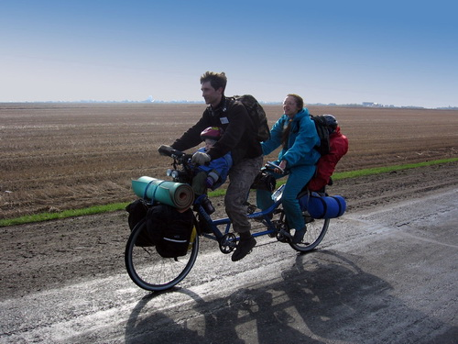
Cycle-tour

Slide 14
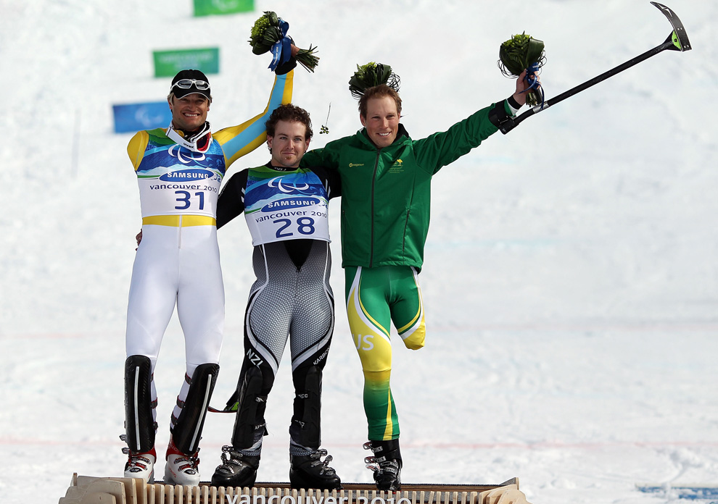
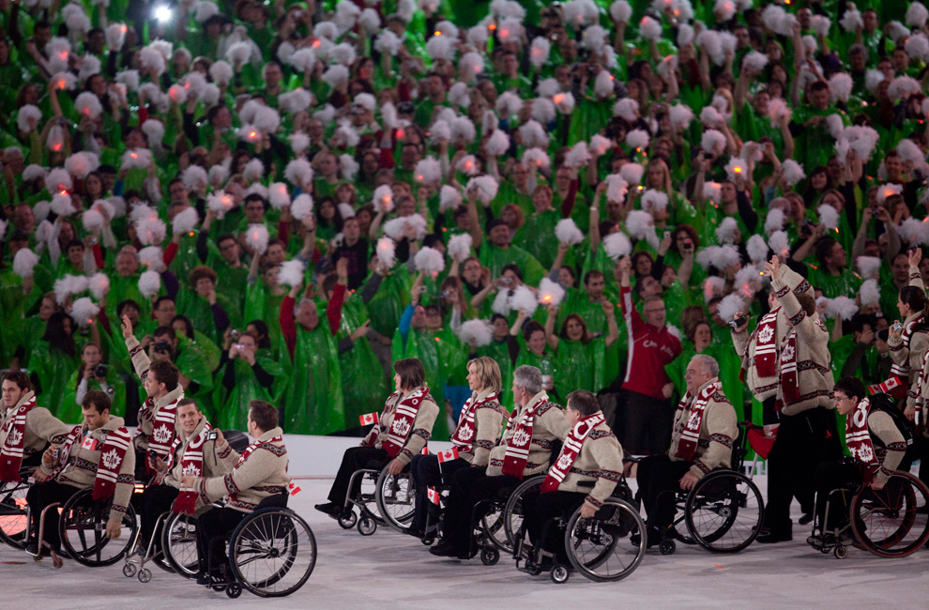
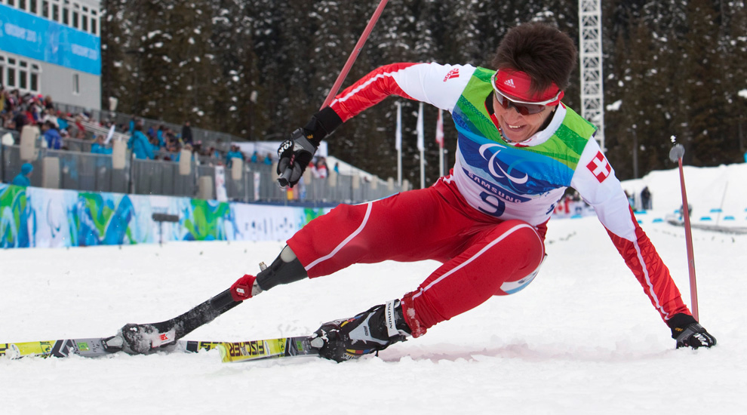
Tourism for people with limited possibilities

Slide 15
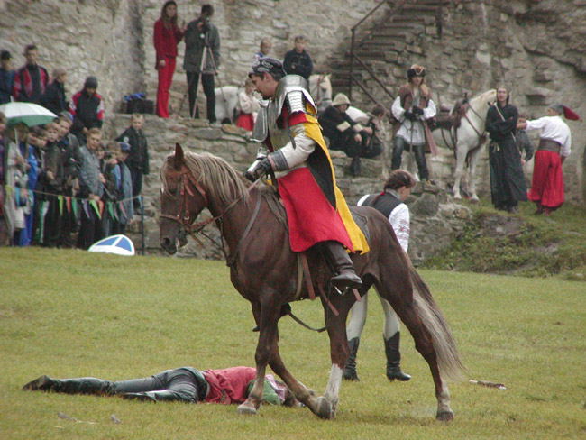
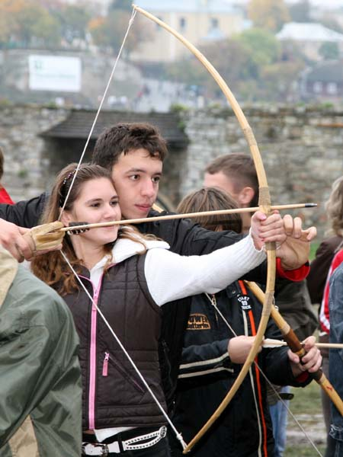
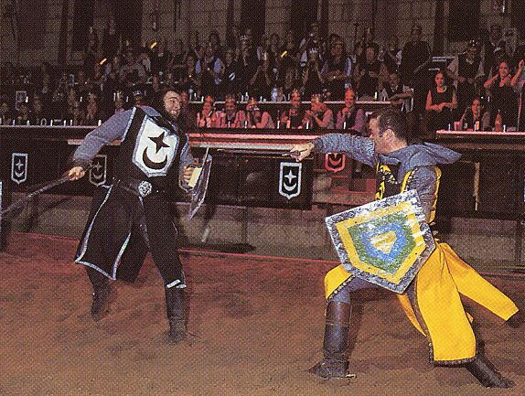
“Knight Festival”

Slide 16
Kőszőnőm!
Рахмет!
Спасибо!
Thank you!

